Slide 1
UNIT-V Preventing and fighting against diseases for good health
Occurrence of infections and reasons,
protection from different types of transmitted infections,
Current trends of socioeconomic impact,
Reducing risks and coping with chronic conditions, Management of chronic illness for Quality of life,
Health and Wellness of youth,
Measuring of health and wealth status.

Slide 2

INFECTION???
Infection is a result of a microorganism (also called a pathogen) entering the body and causing harm.
The organisms that cause infections are many and include things like viruses, bacteria, parasites, fungi
An Infection does not always cause illness

Slide 3
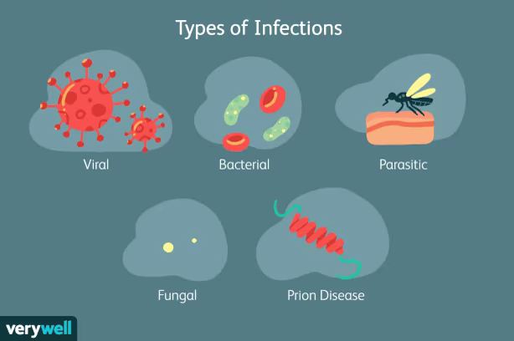

Slide 4
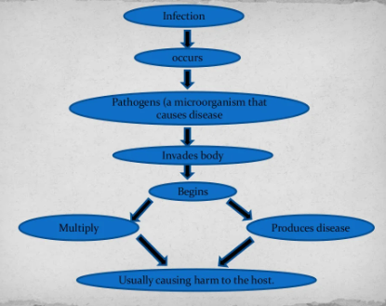
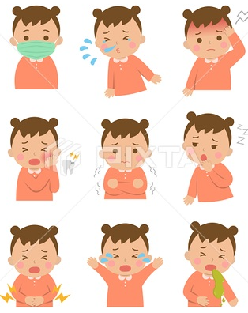
What Happens when a person is infected

Slide 5
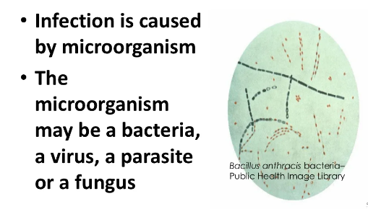
WHAT CAUSES INFECTION

Slide 6
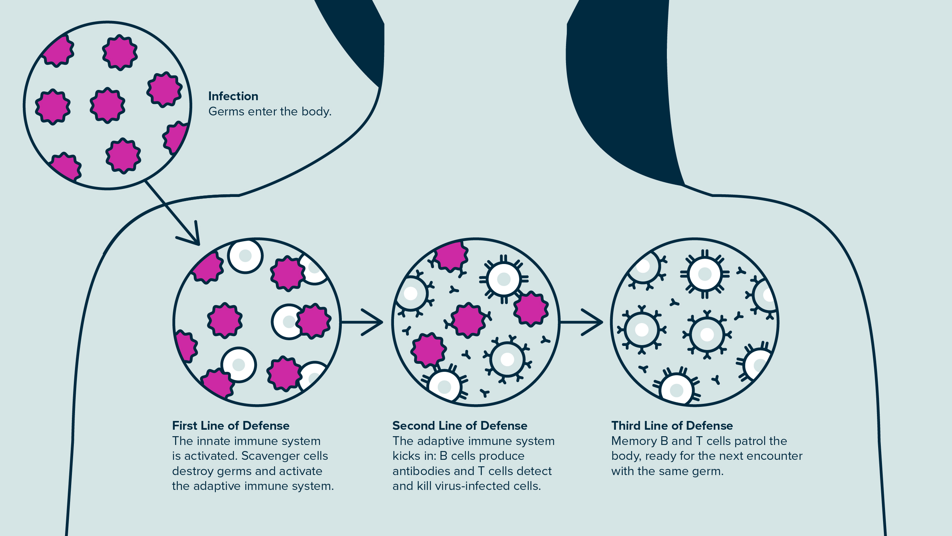
How does the body react to an infection

Slide 7
PRIMARY
SECONDARY
LOCAL
ACUTE
CHRONIC
TYPES OF INFECTION

Slide 8
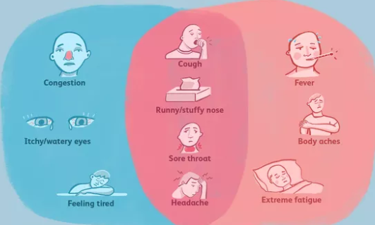
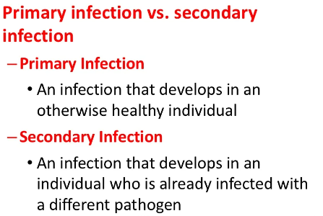
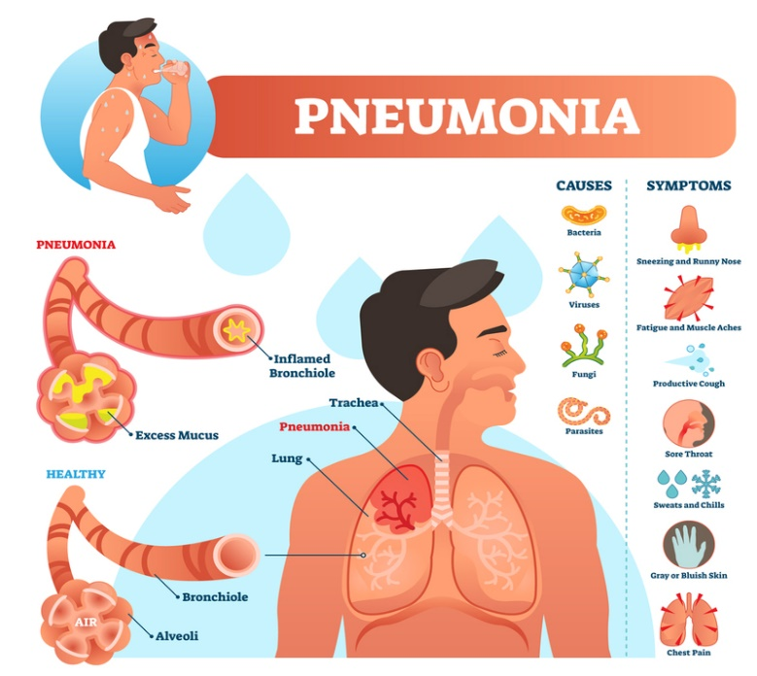
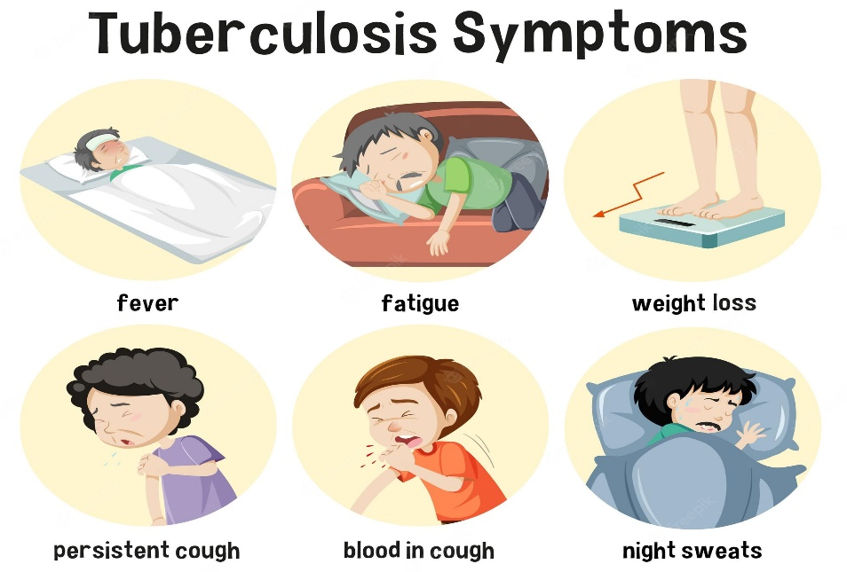

Slide 9
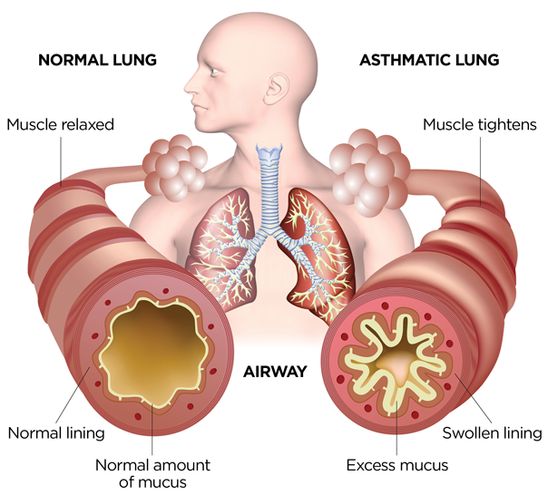
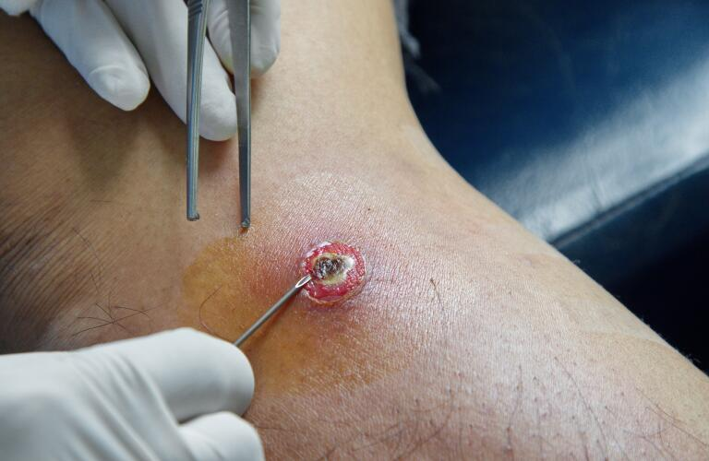
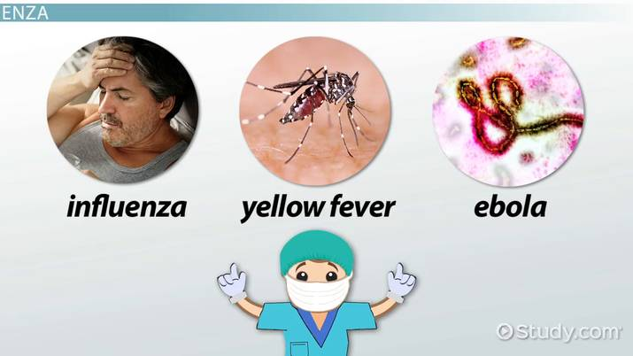
LOCAL INFECTION
ACUTE INFECTION
CHRONIC INFECTION
An acute viral infection is characterized by sudden or rapid onset of disease, which can be resolved quickly by robust innate immune responses exerted by the host or, instead, may kill the host.
Examples
cold or flu
Acute appendicitis
Acute respiratory tract infection,. Etc.,
They usually develop form acute infections and can last for days to months to a life time.
Recovery from this infection is RARE
Examples
Hepatitis C
Asthma., etc.,
An infection that affects only one body part or organ
Examples
Abscesses
An abscess is a painful collection of pus, usually caused by a bacterial infection.
Urinary Track Infections
A urinary tract infection (UTI) is an infection in any part of your urinary system — your kidneys, ureters, bladder and urethra.

Slide 10
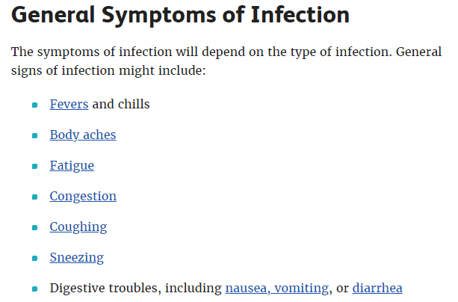

Slide 11
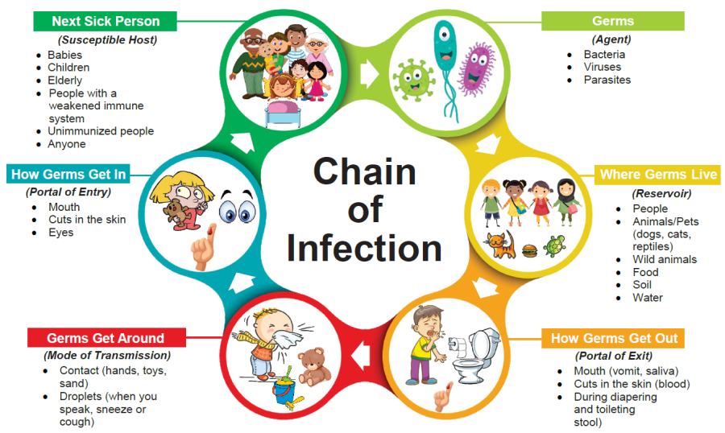

Slide 12
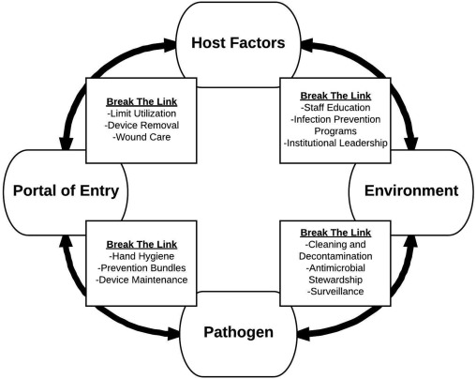
Breaking the Chain of Infection

Slide 13
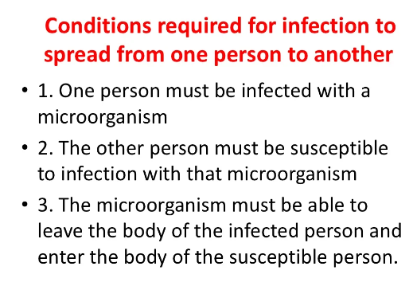

Slide 14
You can prevent many infections and avoid spreading infections through simple tactics such as these:
Avoid close contact with people who are sick.
Cover coughs and sneezes.
Avoid touching your face.
Stay home if you're sick.
Clean and disinfect surfaces that are touched often.
Avoid contaminated food and water.

Slide 15
Socioeconomic Impact
Socioeconomic impact assessment is a methodical procedure in which pros and cons for a whole community or various processes are shown and studied.
Basically in this technique socioeconomic cost is evaluated against the socioeconomic benefit. The method is used to evaluate the economic and social impacts associated with product and processes. Moreover, it tries to consider all types of social, economic, and environmental impacts and consequences for all users in a community or society.
The main aspect of socioeconomic impact assessment is that all identified impacts are expressed in economic terms. Therefore, this method may differ from other methods in the essence of scientific and technical prospect.
Increases in educational attainment and income or decreases in hunger and the incidence of disease are examples of “impact.” Socio-economic “impact” can be positive or negative, intended or unintended, temporary or sustainable over time.
Definition: quantitative evaluation of the utility of projects and public policies, i.e. their creation of collective value net of costs. This method allows all social, environmental, economic and financial impacts of a project or public policy to be measured in a monetary unit.

Slide 16
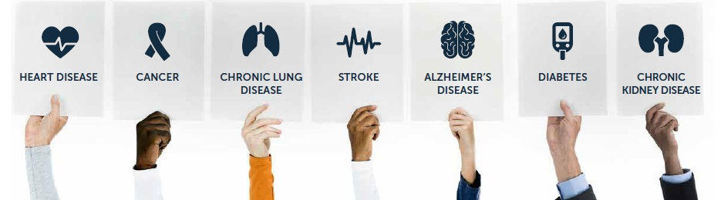
What is chronic disease/illness?
A disease or condition that usually lasts for 3 months or longer and may get worse over time. Chronic diseases tend to occur in older adults and can usually be controlled but not cured.
Chronic diseases are defined broadly as conditions that last for one year or more and require ongoing medical attention, as well as limit activities of daily living.
Example: heart diseases, cancer, diabetes, obesity, asthma.

Slide 17
They are also leading drives of the nation’s large scale health care costs.
Based on the latest data from C D C (center for disease control), 10 most expensive chronic diseases are:
Cardio vascular diseases
Smoking related health issues
Alcohol related health issues
Diabetes
Alzheimer’s disease
Cancer
Obesity
Arthritis
Asthma
Stoke

Slide 18
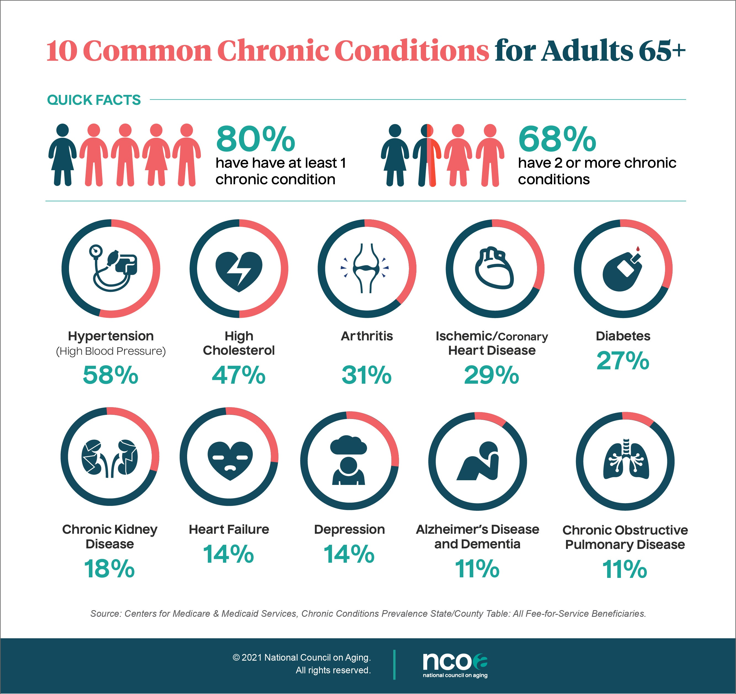

Slide 19
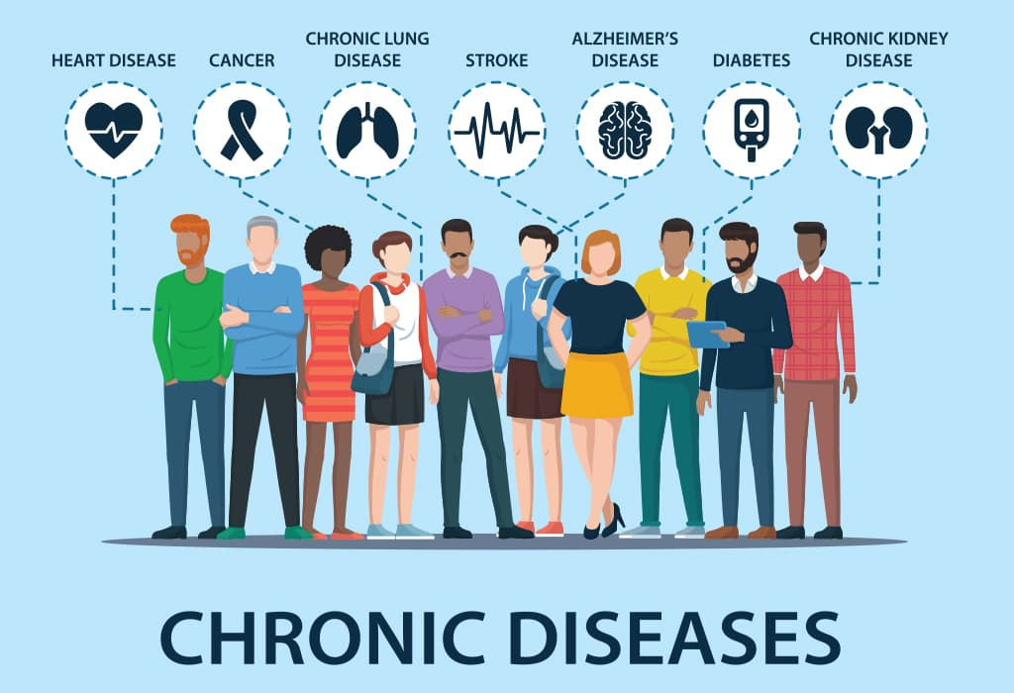
What causes chronic illness?
Many chronic diseases are caused by a short list of risk behaviors:
Tobacco use and exposure to secondhand smoke.
Poor nutrition, including diets low in fruits and vegetables and high in sodium and saturated fats.
Physical inactivity.
Excessive alcohol use.
They are caused by a number of different health factors resulting at simultaneously
They take some time to develop
They last for a long time and often lead to other health problems

Slide 20
Strategies for coping with a chronic condition:
Manage your medications
Remembering to take one pill a day is tough; managing 10 or more is daunting.
Knowing about the drugs you take
why you take them, how best to take them, and what problems to watch out for
Is as important as learning about your condition.
Talking with your doctor, nurse, or a pharmacist can put drug information into perspective.

Slide 21
Make a healthy investment in yourself.
Part of the treatment for almost any chronic condition involves lifestyle changes.
You know the ones we mean
stopping smoking, losing weight, exercising more, and shifting to healthier eating habits.
The people who make such changes are more likely to successfully manage a chronic condition than those who don't.

Slide 22
Understand Your Condition
When you’re living with a long-term condition, it can be helpful to learn everything you can about your symptoms and treatment options.
Ask your doctor specific questions about your condition.
You can also find information online, although some sources are more accurate and reliable than others.
Pay close attention to what seems to ease your symptoms or make them worse.
Use a notebook or calendar to record trends and other insights that might help you manage your symptoms.
Share your notes with your doctor so your healthcare team can better understand how your condition affects you.
Observe your own body

Slide 23
Stay Connected
One of the easiest things to do is to pull away from friends and family.
But communicating honestly is an important part of helping your loved ones understand what you need to cope and how they can be supportive.
Beware of depression.
Dark, dreary moods plague a third or more of people with chronic diseases.
Depression can keep you from taking important medications, seeing your doctor when you need to, or pursuing healthy habits.
Read up on the signs of depression.
Let your doctor know if you think you're depressed or heading in that direction.

Slide 24
Points for reducing risks of chronic conditions:
QUIT SMOKING
EAT HEALTHY
GET REGUALAR PHYSICAL ACTIVITY
AVOID DRINKING TOO MUCH ALCOHOL
GET SCREENED
GET ENOUGH SLEEP
KNOW YOUR FAMILY HISTORY
MAKE HEALTHY CHOICES IN SCHOOL, AT WORK, AND IN THE COMMUNITY

Slide 25
Quality of life:
“Quality of life is defined as an individual’s perception of their position in life in the context of the culture and value systems, in which they live and in relation to their goals, expectations, and standards”.
Simply quality of life means the degree to which an individual is healthy, comfortable, and able to participate in or enjoy life events.
Quality of life has a wide range of contexts. It includes the field of international development, health care, politics and employment

Slide 26
Health related quality of life is an evaluation of quality of life and its relationship with health. In this field quality of life is often regarded in terms of how certain ailment affects a patient on an individual level.
Components of quality of life:
Physical functioning
Psychological status
Social functioning
Disease or treatment

Slide 27
Assessment of quality of life in chronic illness
Till now the assessment of the quality of life of chronically ill was based on how much the disease and treatment interferes with the activities of daily living such as –
Sleeping, Eating, Going to work and Engaging in recreational activities
For patients with more advanced diseases, such assessments include whether the patient is able to bathe, dress, use toilet, be mobile, be content, and eat without assistance
Essentially the quality of life assessment gauge the extent to which a patient’ normal life activities have been compromised by disease and treatment

Slide 28
How to maintain better quality of life in the chronically ill?
Chronic conditions are not cured completely. So looking after our self about good medical advice, living healthy life style, and having positive attitude help in maintaining better quality of life
The measures adopted are:
Finding reliable information about diseases, its treatment and management. This will help the chronically ill patient to feel that he/she in taking positive step and give a feeling of control over their illness.

Slide 29
Setting the patient’s goal- short term goals will give a sense of how the person is progressing
Developing skills to manage the chronically ill patient’s pain and fatigue
Getting emotional support: Speaking to others who are going through what the patient is going through, and leaning on family and friends when there is need.
Planning for the future
Understanding the medication. This includes what it is specifically for. It provides special instruction to be followed in taking medicine/ treatment and potential side effects.

Slide 30
Pain management
Taking pain relieving medicine. Medication includes both non-prescription medication and prescription medication
Under going physical therapies. There are many non-drug treatments. A combination of treatments and therapies (Physio therapy) is some time more effective. Non drug therapies include cognitive behavioral therapy (cognitive behavioral therapy changes how a person thinks and in turn how he feels and behave).
Physical therapies also are found in stretching exercises, walking and other exercises
Relaxation and stress management techniques
Transcutaneous electrical stimulation therapies
Applying heat packs and cold packs and
Acupuncture

Slide 31
Taking care of mental health:
Symptoms of chronic diseases – tiredness, aches and pains are not quite often visible. It is not just physical symptoms that affect a chronically ill. They can affect the limits on life styles and living with constant pain, it can impact mentally too.
Worrying or thinking negatively adds to the patient’s anxiety or stress. They can affect the overall health.
What are the ways to reduce worrying?
Write down the concerns and the possible consequences even if they are negative
Find out the information about prognosis
Talking to a friend, a supporting group or seek specialist help
Focusing on a variety of things each day

Slide 32
Good life style choices for better quality of life
Maintain a healthy life style can help the chronically ill patient to feel well, while living with chronic illness and its condition. This includes eating well, doing as much physical activity as the patient’s condition will allow, and getting good rest.
Trying to do some physical activity each day, even if it is only a small amount, can help with managing pain and lift your mood. Speak with the doctor or physiotherapist about exercise that may help. Sleep is also very important if there is a health condition

Slide 33
Getting support from others for better quality of life:
Social support can help chronically ill person to maintain a good quality of life.
When a chronically ill person has a long term adverse health condition the person must plan to catch up with family and friends and inform about their condition and let them know how they can help
Consider new sources of support such as support groups, clubs, interest group and volunteer opportunities.

Slide 34
Dealing with multiple health condition:
To achieve this chronically ill person need to deal with a number of health care professionals. The most important thing to remember about seeing multiple healthcare professionals is to let each one know who else the patient are seeing and for what health condition.

Slide 35
Health and wellness
Health is a state of well-being
Wellness is the state of living a healthy life styles
Health refers to physical, mental and social Well=being
Wellness aims to enhance well-being. It can affect physical, mental and social well-being

Slide 36
Health and wellness in youth
High levels of health and wellness in youth help them flourish in life as well as act as a protective factor against some of the challenges that may arise during this period.
Youth with strong mental well-being are able to manage their emotions, enjoy positive relationships with friends and family.

Slide 37
Challenges facing youth
In may 2014 W H O published a major report called “Health for the world’s adolescent.”
The report analyses what is known about adolescents’ health
It includes topic of what promotes or undermines it, gaps in policies and services, and draws together guidance and recommendations.

Slide 38
Main health issues faced by youth
Early pregnancy and childbirth
• Complications linked to pregnancy and childbirth are the second cause of death for 15-19-year-old girls globally.
• One of the Millennium Development Goals, is to achieve universal access to reproductive health, for which one of the indicators is the pregnancy rate among the 15 to 19 age group.

Slide 39
2. HIV
• More than 2 million adolescents are living with HIV. Although the overall number of HIV related deaths is down 30% since the peak 8 years ago, estimates suggest that HIV deaths among adolescents are rising
3.Other Infectious Diseases
• Improved childhood vaccination has resulted in reducing death and disability from measles
• However Diarrhoea , lower respiratory tract infections and meningitis are among the top 10 causes of death for 10 to 19 years old

Slide 40
4.Mental Health
Depression is the top cause of illness and disability among adolescents and suicide is the third cause of death. Violence, poverty, humiliation and feeling devalued can increase the risk of developing mental health problems.
Building life skills in children and adolescents and providing them with psychosocial support in schools and other community settings can help promote good mental health.

Slide 41
5.Violence
Violence is a leading cause of death. An estimated 180 adolescents die every day as a result of interpersonal violence. Around 1 of every 3 deaths among adolescent males in the low- and middle income countries is due to violence
Globally, some 30% of girls aged 15 to 19 experience violence by a partner
Promoting nurturing relationships between parents and children early in life, providing training in life skills, and reducing access to alcohol and firearms can help to prevent violence.

Slide 42
6. Alcohol and drugs
Harmful drinking among adolescents is a major concern in many countries.
It reduces self-control and increases risky behaviours, such as unsafe sex.
It is a primary cause of injuries (including those due to road traffic accidents), violence (especially by a partner) and premature deaths.
Setting a minimum age for buying and consuming alcohol and regulating
how alcoholic drinks are targeted at the younger market
are among the strategies for reducing harmful drinking.
Drug use among 15 to 19 year olds is also a concern

Slide 43
7.Injuries
Unintentional injuries are a leading cause of death and disability among adolescents. In 2012, some 120 000 adolescents died as a result of road traffic accidents.
Young drivers need advice on driving safely
Laws that prohibit driving under the influence of alcohol and drugs need to be strictly enforced. Blood alcohol levels need to be set lower for teenage drivers.
Graduated licenses for novice drivers with zerotolerance for drink-driving are recommended

Slide 44
8.Malnutrition and obesity
Many boys and girls in developing countries enter adolescence undernourished, making them more vulnerable to disease and early death.
The number of adolescents who are overweight or obese is increasing in both low and high-income countries.

Slide 45
9.Exercise and nutrition
Available survey data indicate that fewer than 1 in every 4 adolescents meets the recommended guidelines for physical activity – 60 minutes of moderate to vigorous physical activity daily.
Anemia resulting from a lack of iron affects girls and boys, and is the third cause of years lost to death and disability. Iron and folic acid supplements help to promote health before adolescents become parents.
Developing healthy eating and exercise habits at this age are foundations for good health in adulthood. Reducing the marketing of foods high in saturated fats, trans-fatty acids, free sugars, or salt and providing access to healthy foods and opportunities to engage in physical activity are important for all but especially children and adolescents

Slide 46
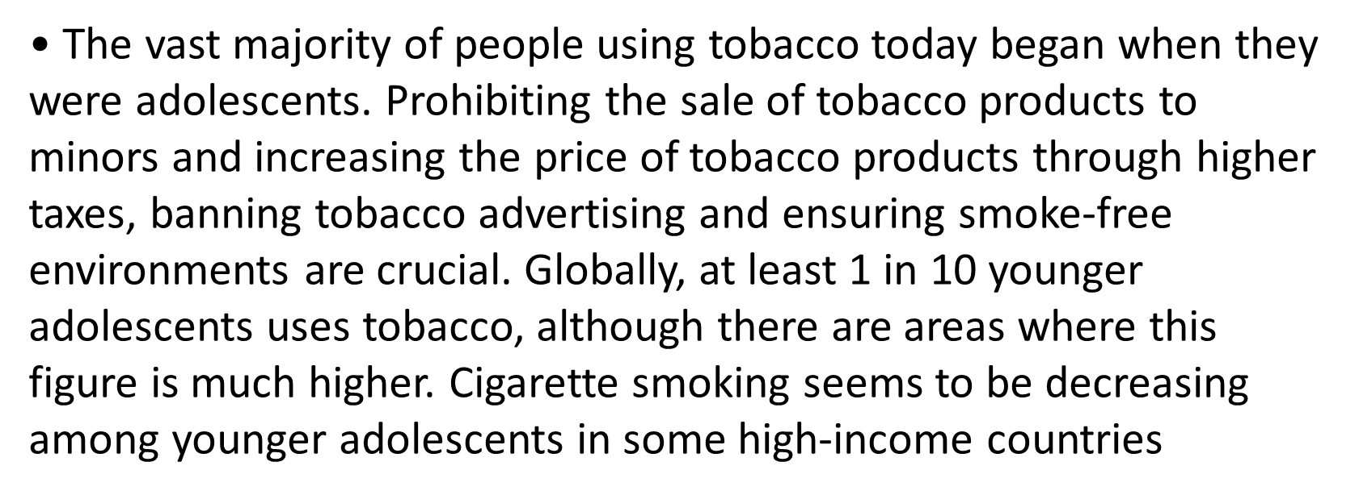
10. Tobacco Use

Slide 47
Health status
The W H O definition:
The state of health of a person or population assessed with reference to morbidity, impairments, anthropological measurements, mortality, and indicators of functional status and quality of life.

Slide 48
Types of health status
Functional health
Disability days
Activity limitation
Health expectancy and
Disability free life expectancy

Slide 49
What is the best predictor of health status?
Earlier rising income and subsequent improved standards of living were thought to be the most important factors contributing to a long and healthy life
New research has shown that the level of education a person has is a much better predictor of life expectancy
Measures of health status:
Life expectancy.
Health adjusted life expectancy.
Morbidity.
Under-five mortality.
Burden of disease.
Disability adjusted life year.
Incidence.
Prevalence.

Slide 50
Wealth Status:
What Is Wealth?
Wealth measures the value of all the assets of worth owned by a person, community, company, or country.
Wealth is determined by taking the total market value of all physical and intangible assets owned, then subtracting all debts.
Essentially, wealth is the accumulation of scarce resources.
Specific people, organizations, and nations are said to be wealthy when they are able to accumulate many valuable resources or goods.
Wealth can be contrasted to income in that wealth is a stock and income is a flow, and it can be seen in either absolute or relative terms.

Slide 51
How to Measure Wealth:
Measuring wealth in terms of money overcomes the problem of evaluating wealth in the form of different kinds of goods.
These values can then be added or subtracted together.
This, in turn, permits the convenient use of net worth as a measure of wealth. Net worth is equal to assets minus liabilities.
For businesses, net worth is also known as shareholders’ equity or book value.
In common sense terms, net worth expresses wealth as all the real resources under one's control, excluding those that ultimately belong to someone else.
Research has consistently shown that people's perception of their own wellbeing and happiness depends much more on their estimates of wealth relative to other people than on absolute wealth.
This is also part of why the concept of wealth is usually applied only to scarce economic goods; goods that are abundant and free for everyone provide no basis for relative comparisons across individuals.

